Slide 1
Ridge regression
蒋智超
2022年 秋

Slide 2

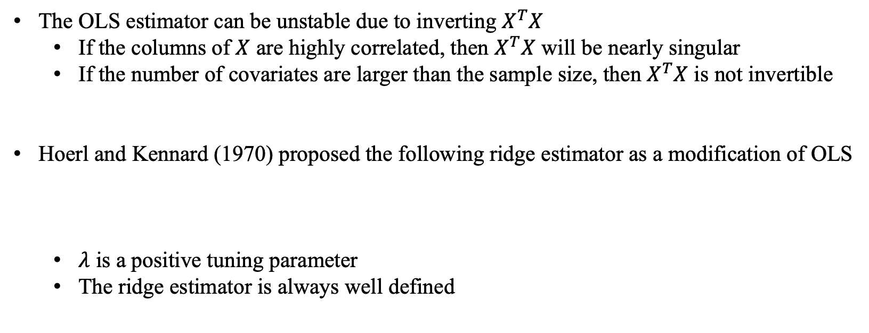
Motivation
The OLS estimator can be unstable due to inverting $X^{T}X$
If the columns of $X$ are highly correlated, then $X^{T}X$ will be nearly singular
If the number of covariates are larger than the sample size, then $X^{T}X$ is not invertible
Hoerl and Kennard (1970) proposed the following ridge estimator as a modification of OLS
$λ$ is a positive tuning parameter
The ridge estimator is always well defined

Slide 3
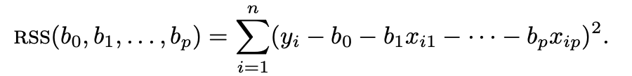
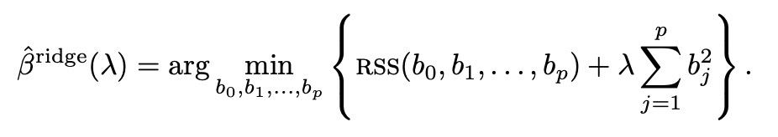
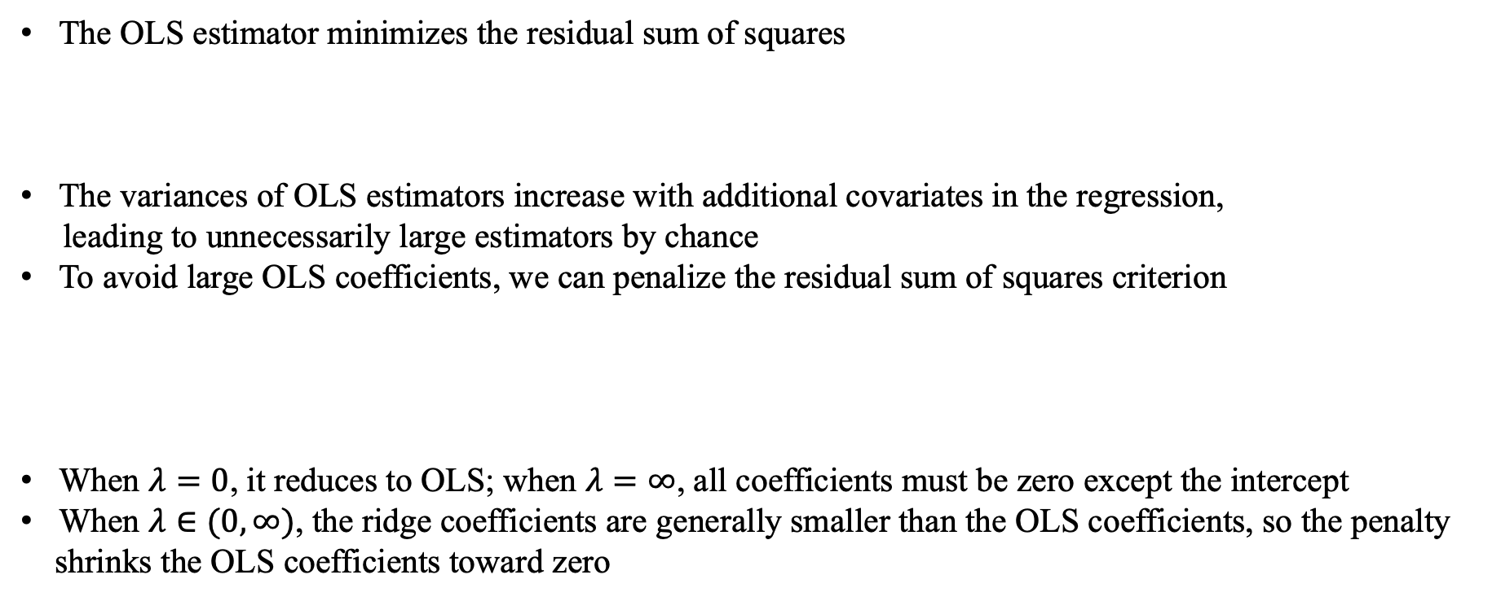
Motivation
The OLS estimator minimizes the residual sum of squares
The variances of OLS estimators increase with additional covariates in the regression,
leading to unnecessarily large estimators by chance
To avoid large OLS coefficients, we can penalize the residual sum of squares criterion
When $λ=0$, it reduces to OLS; when $λ=∞$, all coefficients must be zero except the intercept
When $λ∈(0,∞)$, the ridge coefficients are generally smaller than the OLS coefficients, so the penalty
shrinks the OLS coefficients toward zero

Slide 4
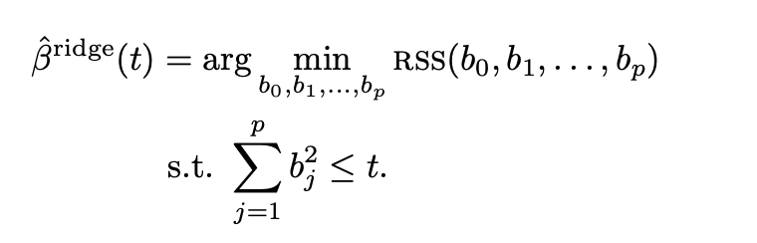

Dual problem
A dual problem in optimization
For a given $λ$, we can always find a $t$ with the same solution

Slide 5
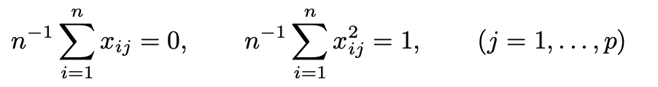

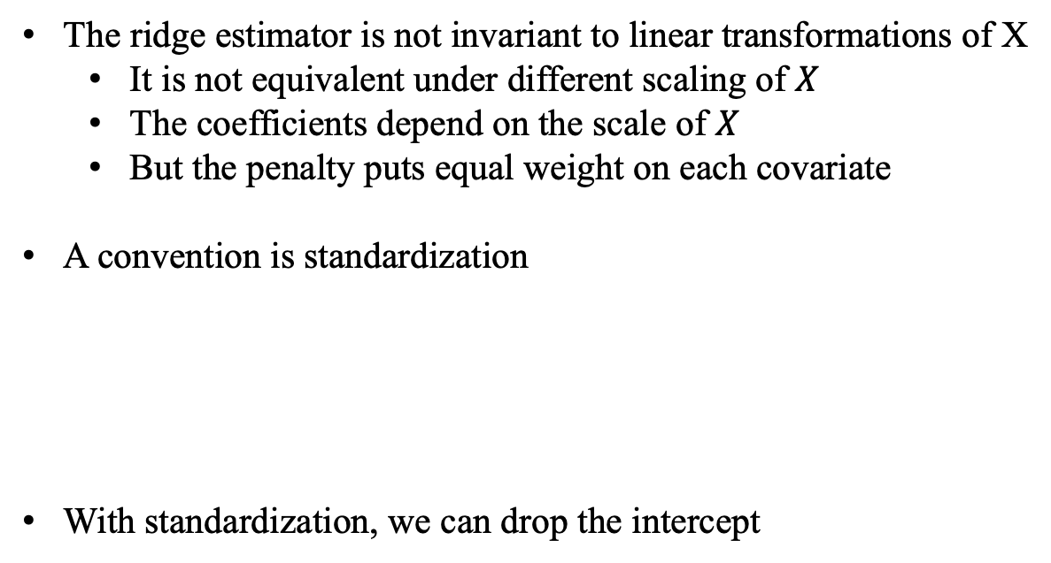
Ridge estimator
The ridge estimator is not invariant to linear transformations of X
It is not equivalent under different scaling of $X$
The coefficients depend on the scale of $X$
But the penalty puts equal weight on each covariate
A convention is standardization
With standardization, we can drop the intercept
Notes:
In practical data analysis, the covariates may have concrete meanings. In those cases, you may not want to scale the covariates. However, the results below do not rely on the choice of scaling although it requires centering the covariates and outcome.

Slide 6

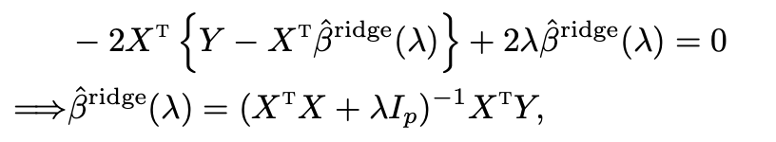

Ridge estimator
Using the matrix form, the ridge estimator minimizes
Predicted vector
Hat matrix
Notes:
when λ > 0, it is not a projection matrix

Slide 7


Ridge estimator
In R, lm.ridge function first computes the ridge coefficient based on the standardized
covariates and outcome, and then transforms them back to the original scale
Means
Standard deviation
Ridge coefficients based on standardized covariates and outcome

Slide 8

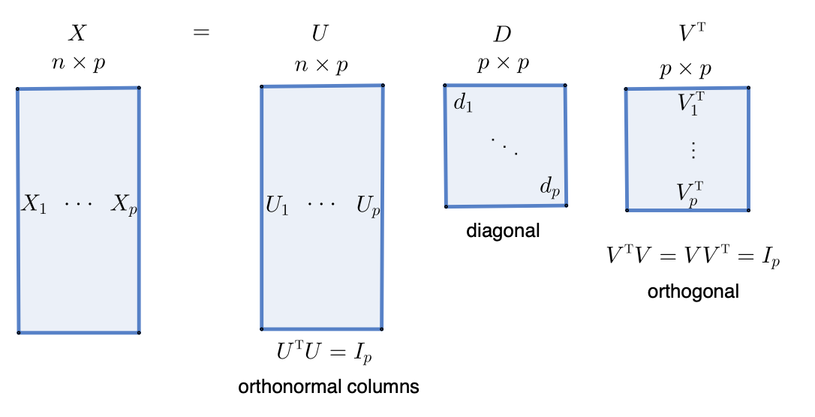

Computation
SVD decomposition of the covariate matrix
Notes:
when λ > 0, it is not a projection matrix

Slide 9
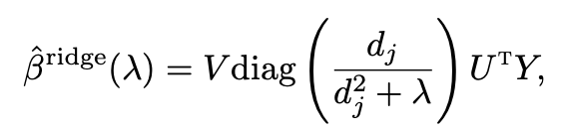
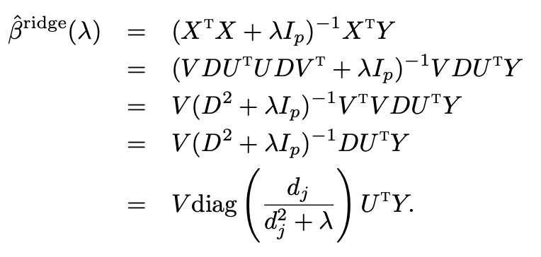
Computation
Proof:

Slide 10
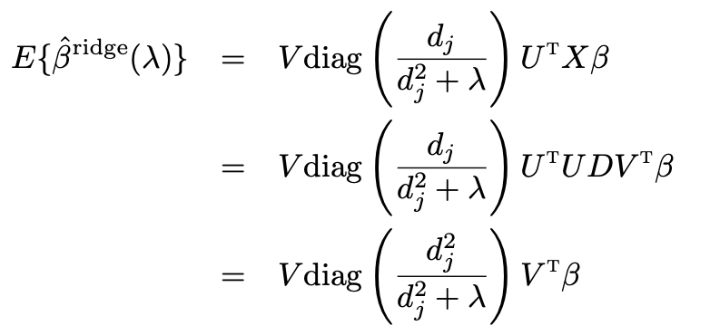
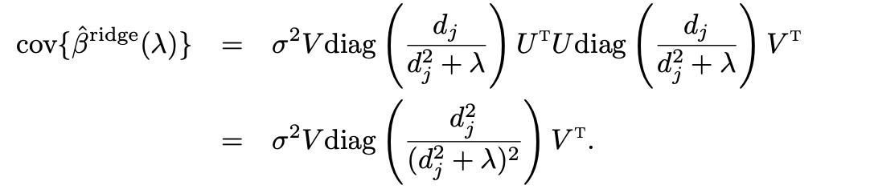
Statistical properties
Can ridge regression improve OLS? (Gauss-Markov model)

Slide 11
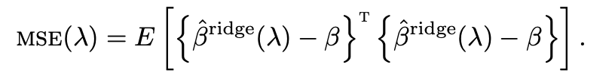
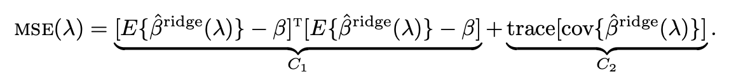
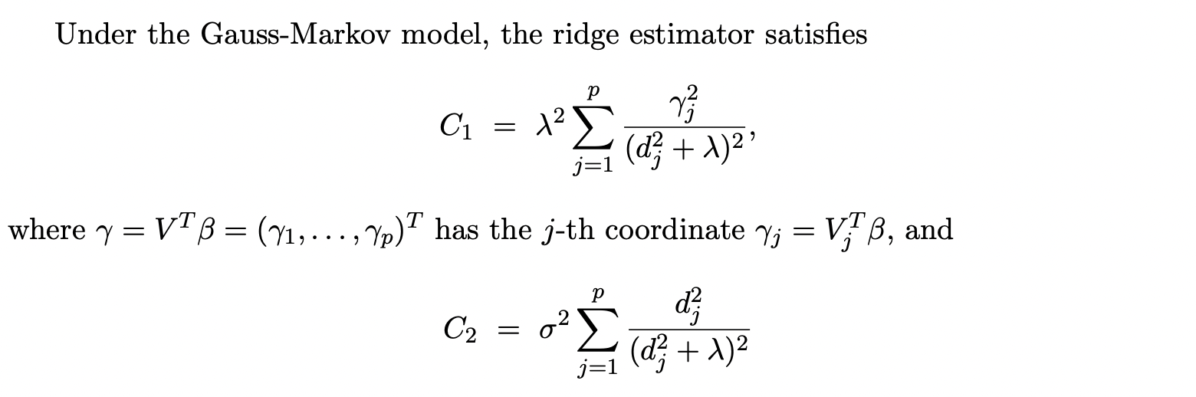
Statistical properties

Slide 12
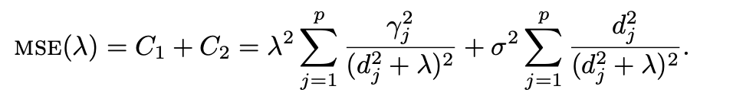
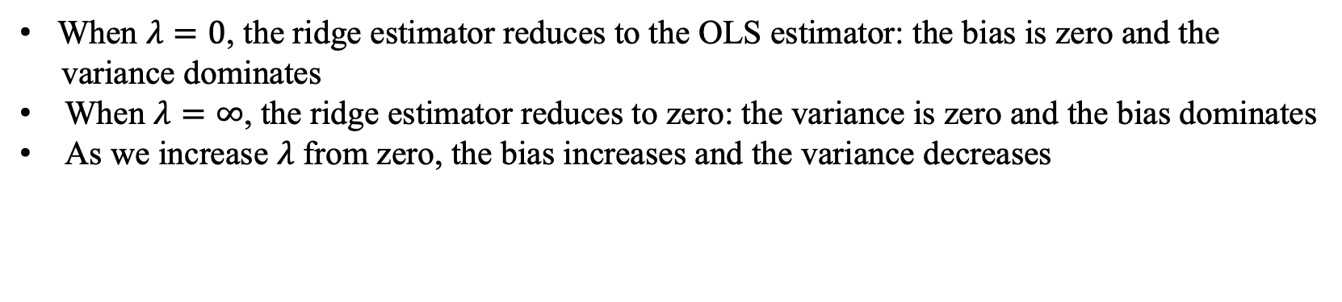
Bias-variance tradeoff
When $λ=0$, the ridge estimator reduces to the OLS estimator: the bias is zero and the
variance dominates
When $λ=∞$, the ridge estimator reduces to zero: the variance is zero and the bias dominates
As we increase $λ$ from zero, the bias increases and the variance decreases
Notes:
Question: can the MSE of ridge estimator be lower than that of OLS?

Slide 13
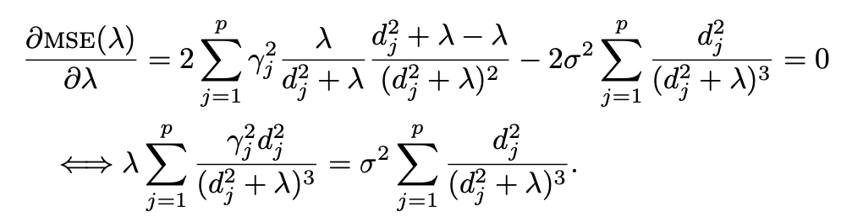

Selection of the tuning parameter
Selecting the tuning parameter based on parameter estimation
Choose the $λ$ that minimizes the MSE
We do not know the values of $γ$ and $σ^{2}$

Slide 14
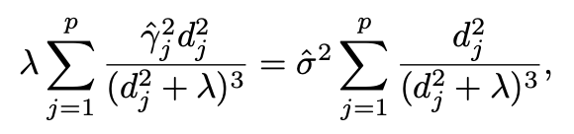
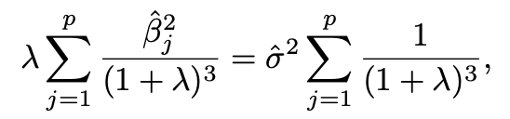


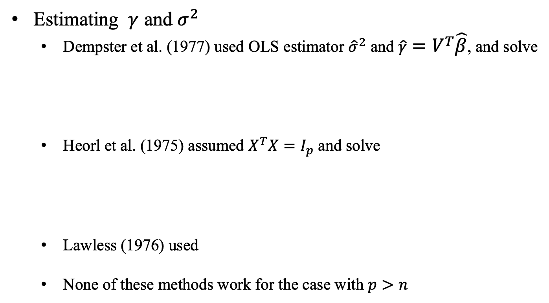
Selection of the tuning parameter
Estimating $γ$ and $σ^{2}$
Dempster et al. (1977) used OLS estimator ${\hat{σ}}^{2}$ and $\hat{γ}=V^{T}\hat{β}$, and solve
Heorl et al. (1975) assumed $X^{T}X=I_{p}$ and solve
Lawless (1976) used
None of these methods work for the case with $p>n$

Slide 15






Selection of the tuning parameter
Selecting the tuning parameter based on prediction
PRESS statistic for ridge regression based on leave-one-out formula
Ridge coefficient
Residual vector
Leverage score
Predicted residual
Leave-one out formulas

Slide 16
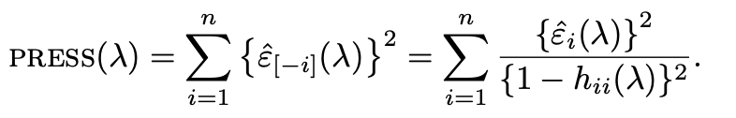
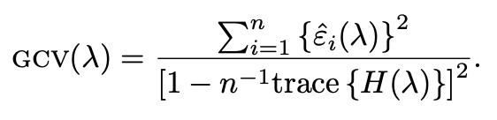
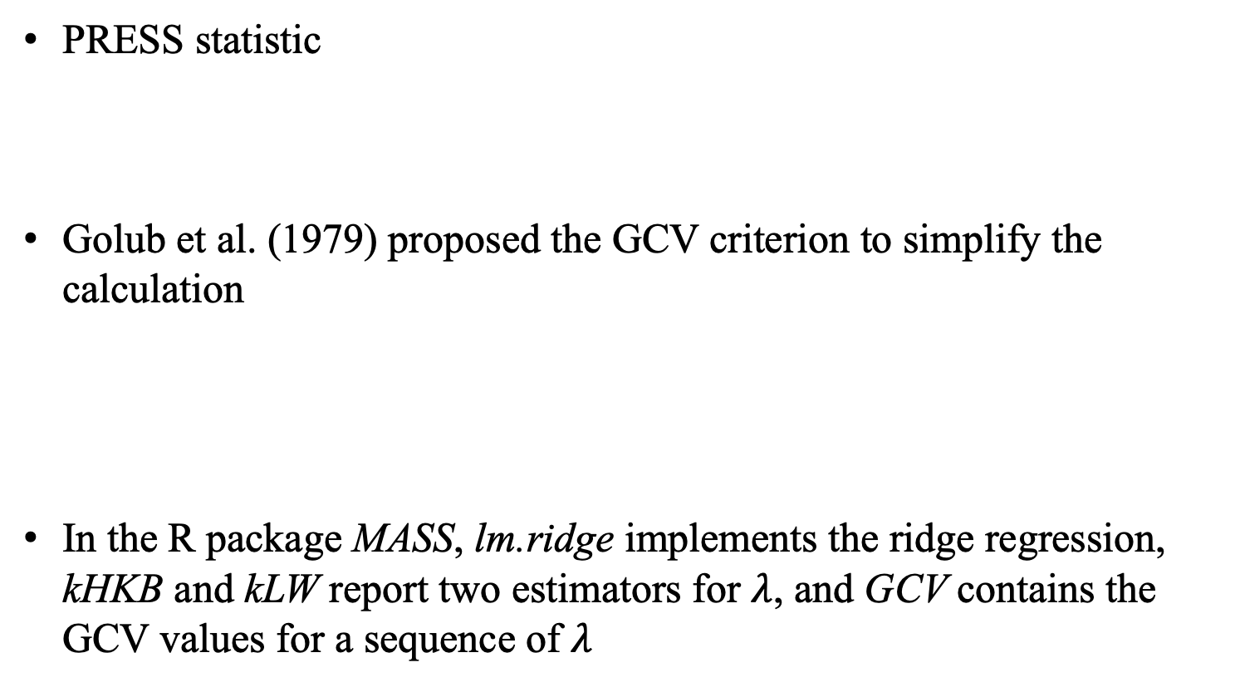
Selection of the tuning parameter
PRESS statistic
Golub et al. (1979) proposed the GCV criterion to simplify the calculation
In the R package MASS, lm.ridge implements the ridge regression, kHKB and kLW report two estimators for $λ$, and GCV contains the GCV values for a sequence of $λ$

Slide 17
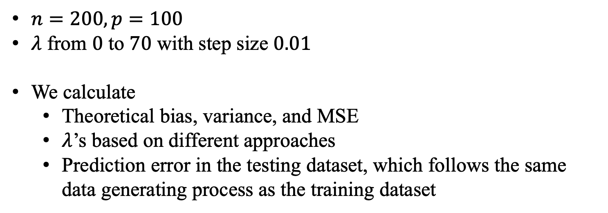
Simulation
$n=200, p=100$
$λ$ from $0$ to $70$ with step size $0.01$
We calculate
Theoretical bias, variance, and MSE
$λ$’s based on different approaches
Prediction error in the testing dataset, which follows the same data generating process as the training dataset

Slide 18
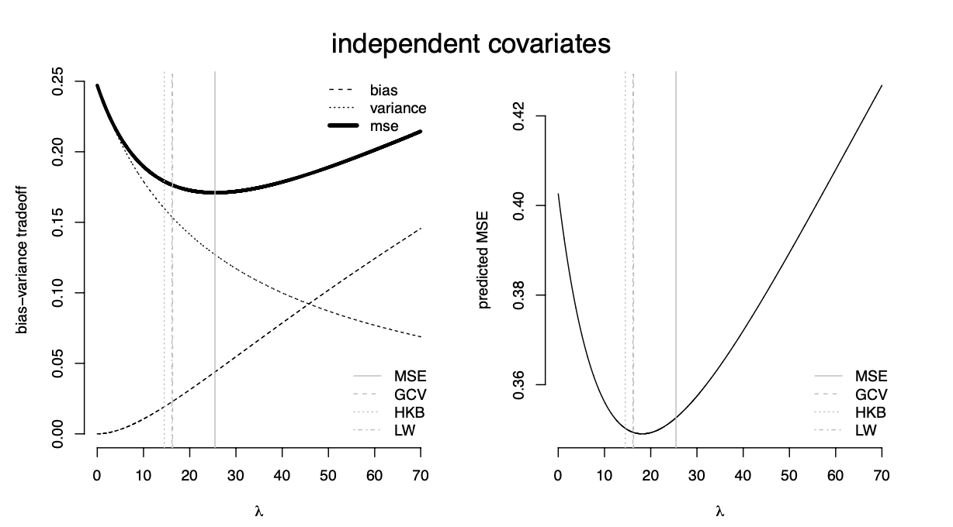
Simulation

Slide 19
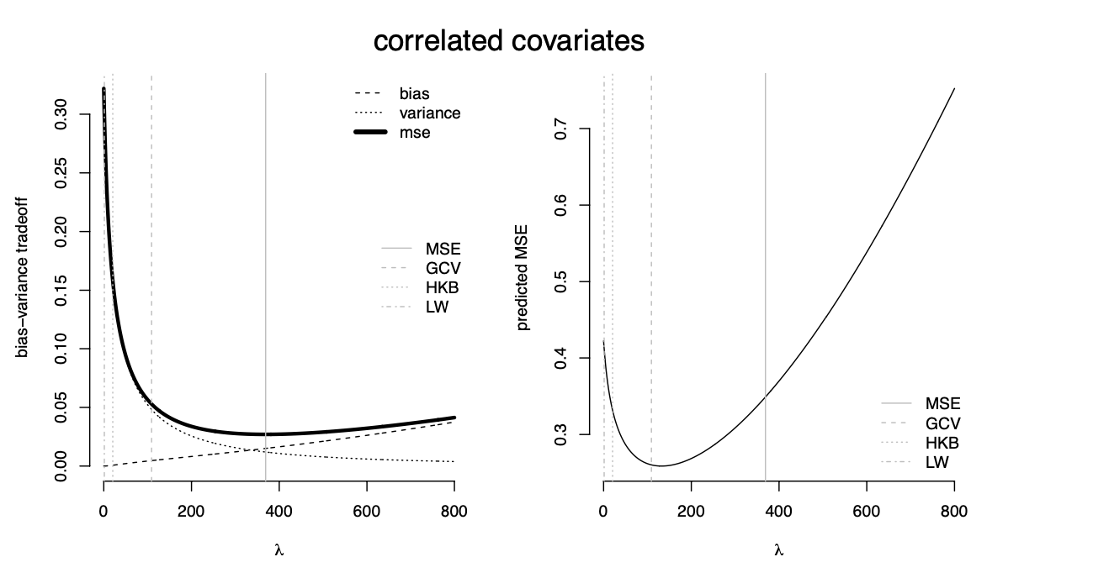
Simulation

